Slide 1

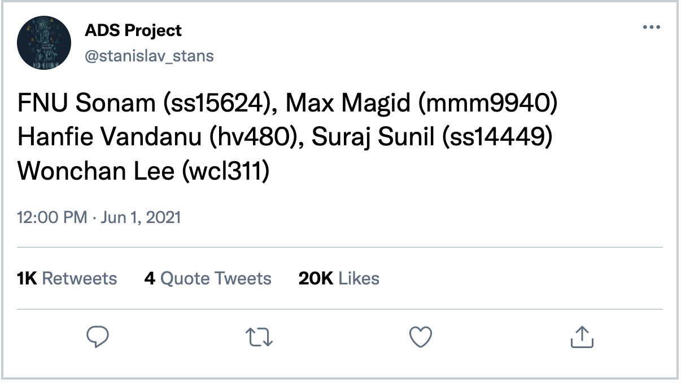
DISASTER DETECTION SYSTEM
Using Real Time Analysis of Twitter Data
Applied Data Science

Slide 2
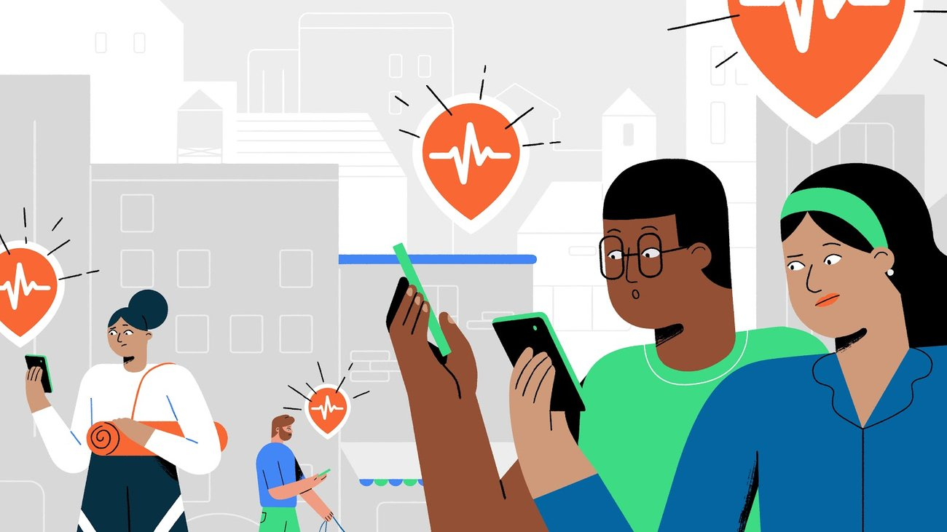



INTRODUCTION
Using the power of ML algorithms + crowdsourced twitter data for social good
Real time disaster management and relief efforts on-the-go

Slide 3
BACKGROUND
Public health implications of social media use during natural disasters, environmental disasters, and other environmental concerns:
Usage of social media to disseminate information, predict data and provide early warnings
Gain insight into public opinions and allowing public health workers and emergency responders to act quickly and efficiently to prevent casualties and lives.
Real-Time Crisis Mapping of Natural Disasters Using Social Media :
Using statistical analyses with geoparsed real-time tweet data streams
Comparison of five-day tweet crisis maps gathered from satellite and aerial imagery for official post-event impact assessment.

Slide 4

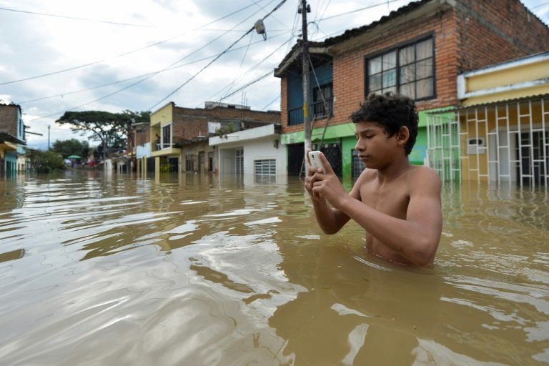

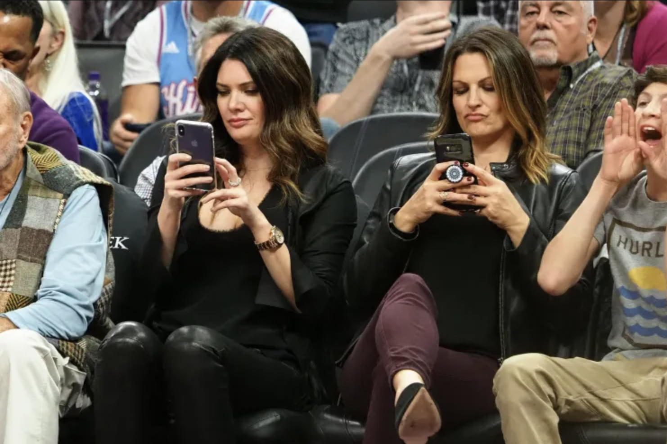
DATA
Tweets from disaster zone
Training Dataset
We obtained a 10,000 tweet labelled dataset from Kaggle
More general tweets
Testing Dataset
We sampled a 10,000 Tweets from Twitter API

Slide 5
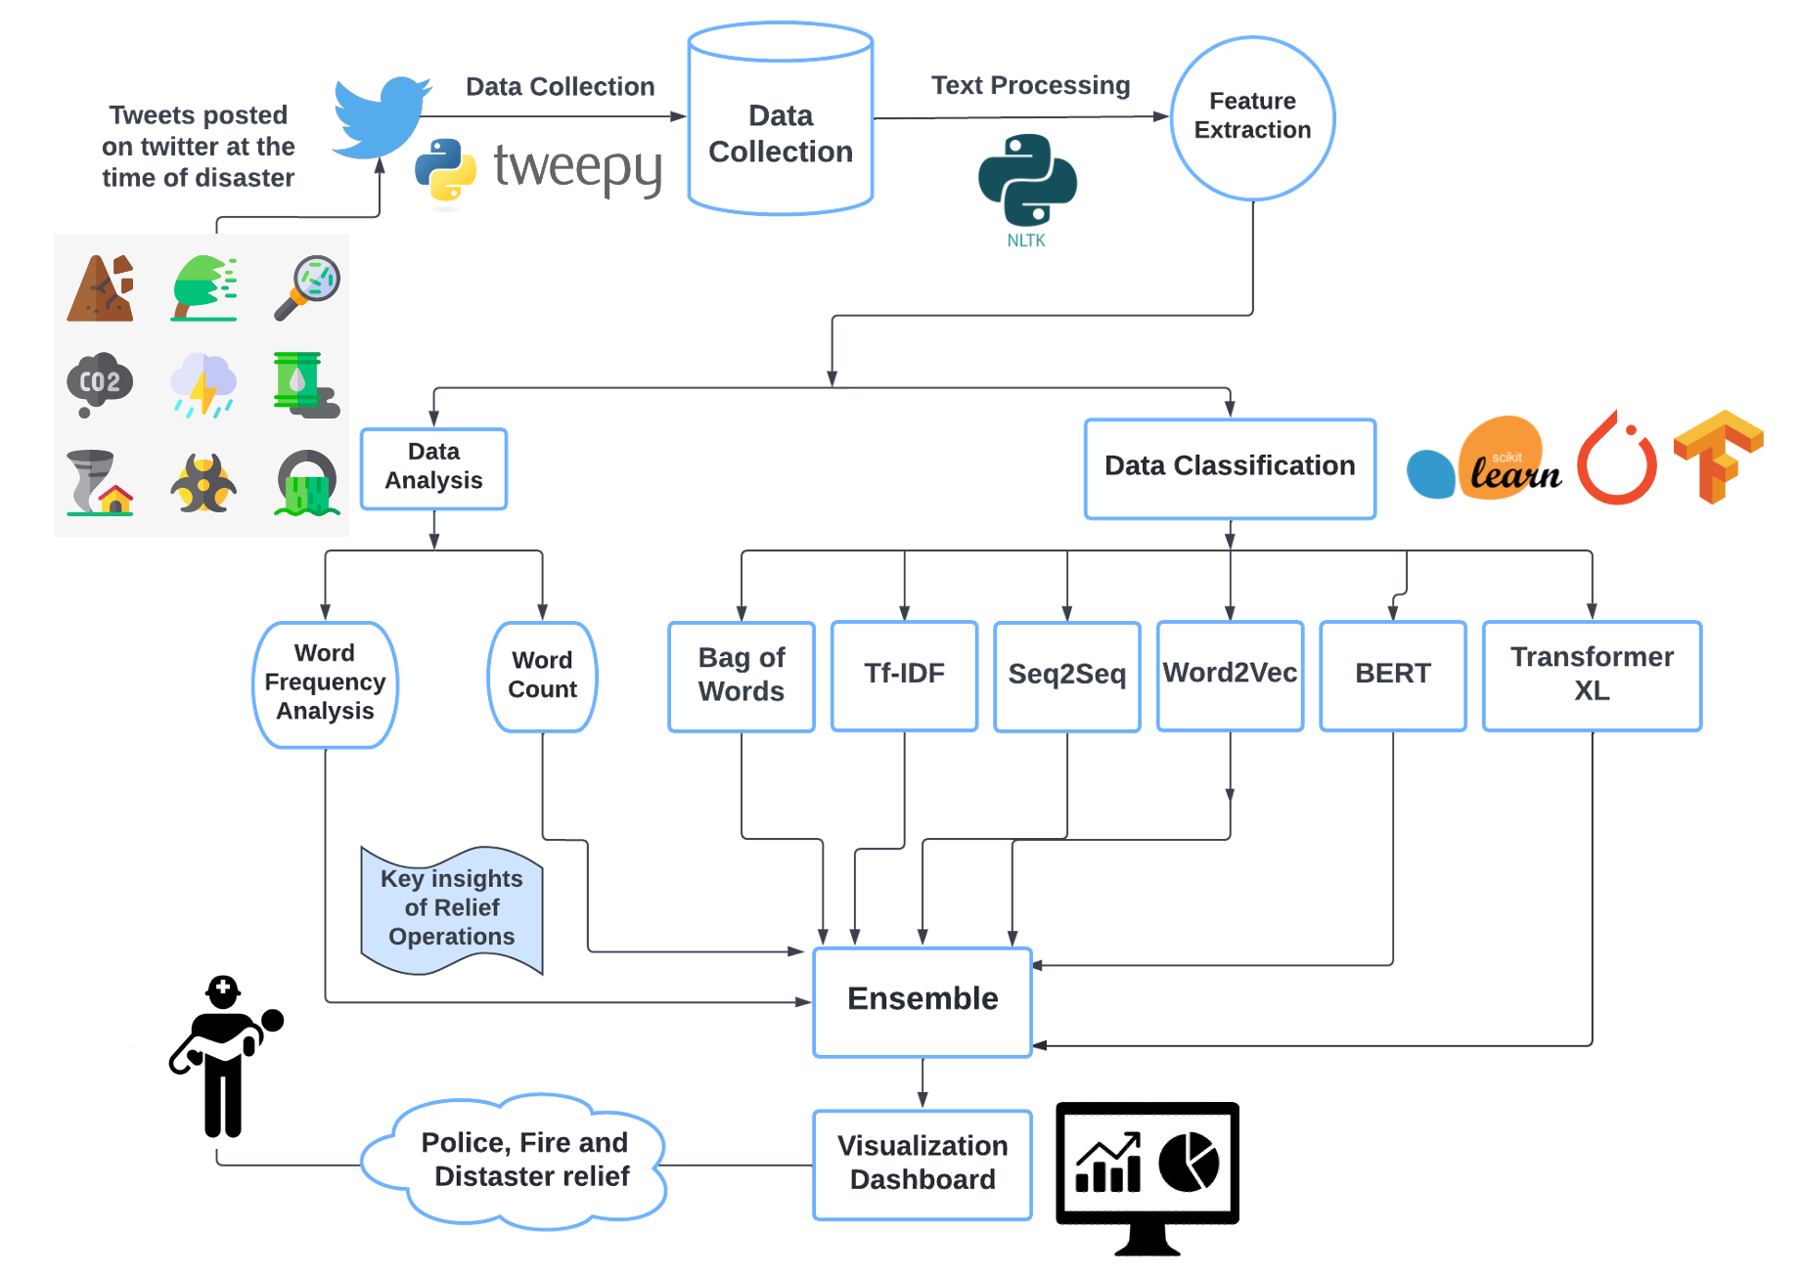
METHODOLOGY
Collect tweets data from twitter stream API
Train ML and deep learning models on cleaned tweet text to classify if disaster.
Real-time inference on twitter stream (test data)
Plot intensity hotspots based on identified disaster tweets in visualization dashboard

Slide 6
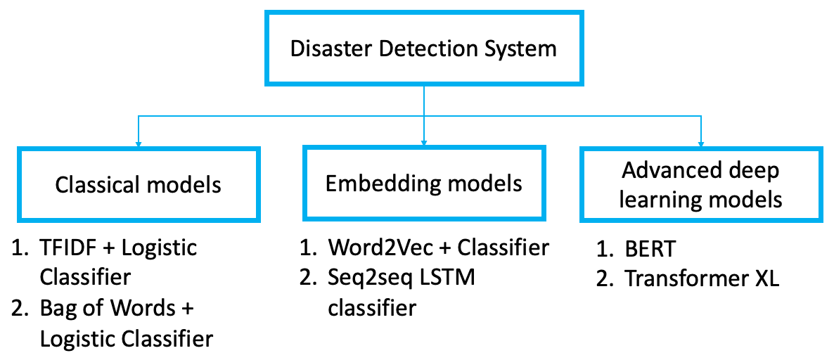
MODELING TECHNIQUES

Slide 7
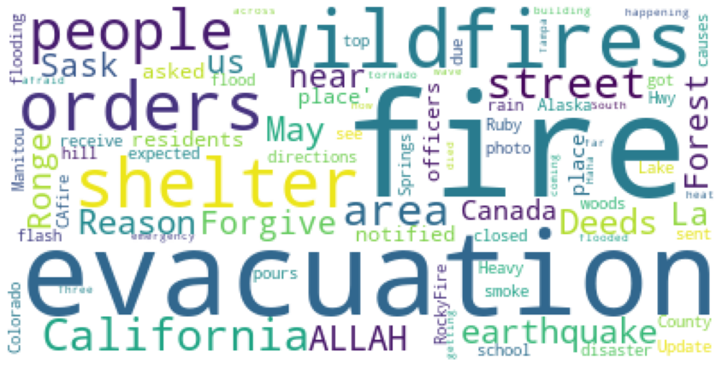
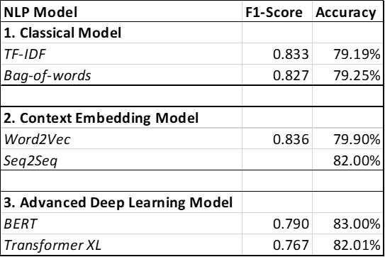
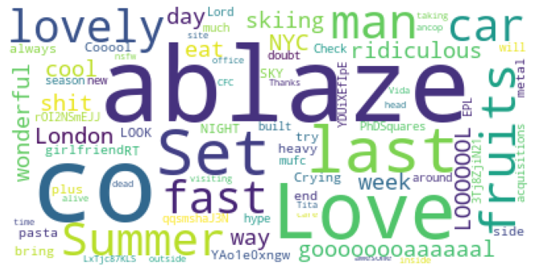
RESULTS
Prediction Label = 1; Tweets During Disaster
Prediction Label = 0, Tweets non-relevant to Disaster

Slide 8
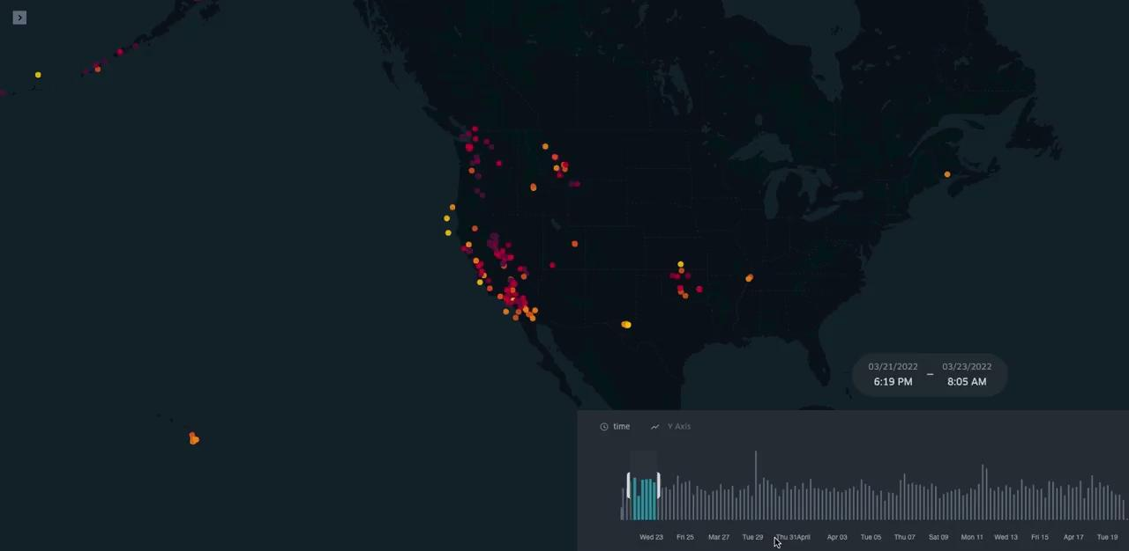
DISASTERS

Slide 9
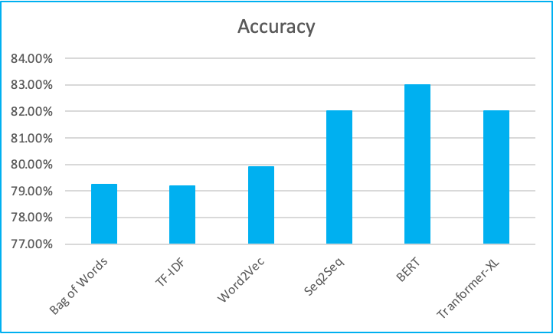

CONCLUSION
After performing the analysis using different type of models like:
Traditional word frequency based models
Context embedding models
Advanced Deep Learning models
BERT model outperformed them all.

Slide 10
FUTURE WORK
Data Inclusion
Adding more social media streams to get more accurate data.
Improving the methodology by exploring other learning models:
Convolutional Neural Network (CNN)
Recurrent Neural Networks (RNN)
Upcoming new advanced models etc.
Collaborating with local governments and civil organizations to improve the real time feed.
Using Latest Models and Ensemble the Results
Local Resources Consulting

Slide 11
THANK YOU

